Slide 1
Navigating Professional Ethics & Boundaries in Home Visiting
Michele Provost, LCSW
Colorado State Office for PAT

Slide 2
Objectives
Learn why professional ethics and boundaries are important
Define core concepts and terminology
Examine PAT model for ethical decision making and practice it
Examine common situations and practical applications

Slide 3
Laying a Foundation

Slide 4
Have you been in a professional situation…
…where you felt uncomfortable regarding a decision you had to make?
…where you felt your personal or cultural values were challenged?
Notes:
-If you answered yes to one or both questions, you have experienced an ethical or boundary conflict
-we have all experienced this in our work in the past and will in the future
-the question isn’t “if” you’ll experience it, it is “when”

Slide 5
Why are professional ethics & boundaries important?
We all make decisions based on our own understanding of what is right and ethical
Situations occur that require professionals to use judgement, values and standards about how to proceed
Determining the “right” thing to do isn’t always clear
Sometimes there is no “correct” way to proceed

Slide 6
What is the purpose of ethics & boundaries?
Help us make hard and difficult decisions
Provide a framework for making tough decisions
Provide some objectivity in emotionally charged situations
Help determine “best” or “least bad” way to proceed
Protect ourselves, our agencies, and our clients

Slide 7
Conflicts can occur with families
You’ve been invited to a child’s birthday party of a family you’re working with. Do you attend? If so, do you bring a gift?
Do you accept the Facebook friend request from the mom on your caseload? What about after she exits your caseload?
A family you’re working with wants to give you a Christmas gift. Do you accept it? Does it depend on the gift’s value? Does it depend on the family?

Slide 8
Conflicts can occur with your agency and co-workers
Your co-worker is selling girl scout cookies to her families. Should you say something? To her? To her boss?
Your supervisor expects you to routinely work beyond your 40 hour work week. You are entitled to overtime compensation, but she refuses to approve it because your program’s budget is tight. How do you handle this?
Your agency routinely takes photos of families at group events and posts them on social media. Parents do not sign a consent. What do you do?

Slide 9
Home visiting compared to other helping professionals
Similarities
Differences
Directly with families or children
Short or long-term
People in crisis
Dealing with personal and emotionally charged situations
Every day, every family, every relationship is different
Work in homes
Sitting on floor
Get dirty
See “behind the curtain”
Discussing multiple areas that are personal
Parenting is very intimate
Notes:
-compare to other helping professionals like therapist, social worker, nurse, teacher
-might be discussing child’s developmental delay, parent’s job and child’s behavior issues all in one visit
-most work happens in family home-don’t have control, their “turf” not yours, nothing more personal than parenting
-your “office” is family home

Slide 10
Core definitions
Notes:
-We’re going to look at some basic terms and definitions used in ethics

Slide 11
Ethics
Study of the moral principals that guide our decision making and behavior
Seeks well reasoned accounts of what should be good and right behavior
Field that is always evolving
Experiences and events shape what a society might view as ethical
Notes:
-what is viewed as ethical behavior evolves and changes over time
-any examples of behavior or issues that have evolved with time and experience?
-consider Me Too movement
-assisted suicide and gay marriage are other good examples of societal change over time

Slide 12
Ethical principals & values
Autonomy—honoring and enabling the rights of individuals to make their own decisions
Beneficence—doing good, helping others, doing what is in other’s best interest
Fidelity—being honest, loyal, and keeping commitments
Justice—fairness in all our actions with others
Nonmaleficence—do no harm to others
Virtue ethics—looks at moral character of a person and their actions, rather than ethical duties
Notes:
-virtue ethics—deals with the honesty and morality of a person. Practicing good habits such as honesty, generosity makes a moral person. Guides a person without specific rules.

Slide 13
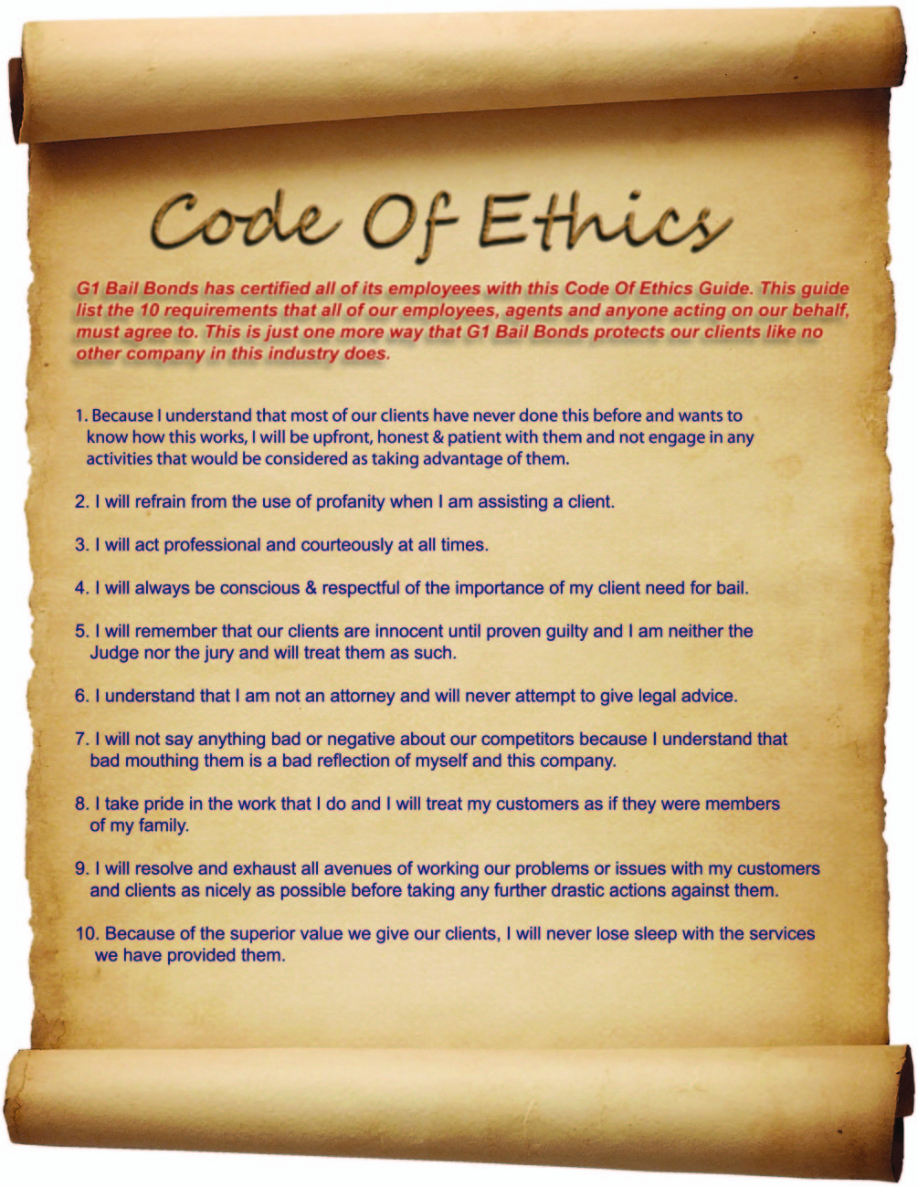
Code of Ethics
Formal statement of what professionals have agreed to in their work
Guides professionals in their work
Identifies expectations of behavior
Notes:
-doctors, nurses, social workers, psychologists, teaching professions have a code of ethics
-Do parent educators/home visitors have a code of ethics? No, because HVs come from many different professions.
-Instead, we are guided by a set of core values—on page 2 of the book

Slide 14
PAT Core Values

Slide 15
Ethical dilemma
“…a situation that requires professionals to use the standards in their field, as well as their moral judgment and personal values, to choose between alternatives as they make a decision from among several imperfect options, all of which involve compromising on ethical principles. The options may involve conflicting values, differing interests, equally justifiable alternatives, and significant consequences…”
Considering Ethical and Professional Behaviors
A guide for parent educators
2017
Notes:
-great definition of ethical dilemma
-bolded phrases of significant importance
-if the decisions were obvious and easy, they wouldn’t be ethical dilemmas

Slide 16
“When it comes to ethical decisions,
there are no answers, there are only decisions.”
-Mel Gray and Jill Gibbons

Slide 17
Personal values
What a person believes to be of importance and worth
How we judge our conduct and character
Influenced by outside forces
Notes:
-values can be influenced by family, friends, education, culture, religion, media
-what are some personal values you have? Family, honesty, loyalty, faith, education, making money

Slide 18
Legal standards
Laws that require professionals to behave in a specific way in a specific situation
Notes:
-legal standards are standards that are set forth in governmental laws
-legal standards can be useful because they tell us what we can and cannot do
-something can be legal, but not ethical, or vise versa
-can you think of an example of something where what is legal and ethical are in conflict?
-physical punishment of children and abortion may be legal, but some might feel it is unethical
-stealing from grocery store is illegal, but some might feel it is ethical to steal baby formula to feed infant
-removing food/water from terminally ill person might be legal, but some feel it is unethical
-sometimes legal standards tell certain professionals what they must do or are required to do, ie. mandatory reporting

Slide 19
Boundaries
Invisible line between a personal and professional relationship
Same behavior may be acceptable in one type of relationship, but not in another type
Setting boundaries is often difficult
Notes:
-we set boundaries with our relationships all the time
-sometimes boundaries are set for us
-same behavior—hugging your aunt vs. hugging your doctor or boss
-not always clear and easy to violate
-often don’t realize a boundary has been violated until after
-we’ll go into boundaries in more detail later

Slide 20
Model for ethical decision making

Slide 21
Ethical decision making elements
Understand process of making good decisions
Practice the skill of making ethical decisions
Reflect on the process
Notes:
-these are the core elements of ethical decision making
-many different decision making models
-Important to practice the skills and not always rely on others to tell you what to do

Slide 22
6-Step decision making model
Considering Ethical and Professional Behaviors
A Parents as Teachers Perspective
Notes:
-PAT has developed a 6-step decision making model for ethical decision making
-available in hard copy book form or in Model Implementation Library
-if have book, feel free to follow along on pages 25-27

Slide 23
Step 1: Identify the problem
Gather information
State the problem clearly, in a sentence or two
Conflict between legal and ethical issues? If so, what are the legal issues? The ethical issues?
If clear legal decision, usually have clear action steps
If no clear legal decision, move to next step
Notes:
-use example of invitation to client’s birthday party

Slide 24
Step 2: Apply code of ethics/principles of field
Is there a professional code of ethics that applies?
What is the guidance from related fields?
Read the standards carefully
Consult with another member of your field or profession
Notes:
-briefly discuss social work code of ethics
-does code of ethics tell me whether to attend party or not? No.
-what principles and values might apply?
-autonomy, beneficence, nonmaleficence, culturally sensitive,

Slide 25
Step 3: Come up with potential solutions
Brainstorm solutions without judgement
Consider all options
Best to have more than 2 options
Consider who needs to be involved (organizations and individuals)
Explore legal issues, policies, other rules
Talk with a peer or supervisor to generate more ideas
Notes:
-to continue party example…
-what are some solutions?
-record answers on flip chart paper
-go to the party, don’t go, go for short time, give family a card or small gift, but don’t go to party
-tell family you have a conflict or its against agency policy
-tell family you’ll attend, but cancel later
-tell family you’re not comfortable attending

Slide 26
Step 4: Evaluate all potential courses of action
Consider the impact on:
the family, parents, child, others
yourself, your peers, your agency
the relationships of those involved
Apply additional considerations
Rank the courses of action
Select a course of action
Consider pros and cons again
Notes:
-party example-how will decision affect the family, the child, my family, my agency
-decide to not go to party because its against agency policy

Slide 27
Step 5: Implement the chosen course of action
Identify the steps and potential barriers
Develop a plan
Strengthen your resolve—the road ahead may be rough
Document actions and consequences, include date and signature when appropriate
When steps are completed, evaluate result
Notes:
-how and when to tell family
-what might be reaction?
-what actually happened? How do I feel?

Slide 28
Step 6: Reflect on thoughts and feelings
Identify your feelings. Normal to have conflicting feelings and discomfort.
May still be pros and cons
What would you do the same or differently in the future?
Notes:
-after a period of time, reflect on process
-would I do the same thing again? Do anything differently?

Slide 29
Practice using model
1. Identify the problem
2. Apply foundational principles of field
3. Come up with possible solutions
4. Evaluate all potential courses of action
5. Implement the chosen course of action
6. Reflect after the situation
Notes:
SMALL GROUPS-
-Let’s practice the 6 steps for this scenario in small groups
-groups of 3 or 4 people for about 10-15 minutes
-all groups work on same scenario—Homeless family
-report to larger group after

Slide 30
Common situations & Practical application
Notes:
-discuss common ethical situations that arise for helping professionals and HVs

Slide 31
Confidentiality
2 important principles:
How to talk to families when services begin
How to maintain confidentiality during service delivery
Potential exceptions to confidentiality rules:
Suspected child abuse/neglect
Danger to themselves or others
Intent to commit a crime (Duty to Warn)
Suspected elder abuse
Notes:
-Important to be upfront and honest with families at enrollment about what will be and what won’t be kept confidential
-how to use outcome/assessment results, how/when to communicate with other agencies
-consent process is key
-maintenance of records, use of technology in general
-should have agency policies about how to handle and store records, both hard copy and electronic
-all states are slightly different, be sure you understand laws
-may have obligation if client says they intend to commit a crime
-famous duty to warn case
-Threats not against individual, but also against organization, activity, event

Slide 32
Competency and professional limits
Parent educators are hired with a set of skills to deliver services
Receive continuing education to maintain and expand level of competency
Notes:
-Hired with a set of skills, knowledge, and competencies to do their job
-we are expected to work within our set of skills and not outside

Slide 33
Competency and professional limits
Working outside competency level
Why does this occur?
What are potential problems?
Importance of resource and referral network
Notes:
-PE can feel like they need to be all things to all people
-”I’m the only one who can help” “I’m the only one who really understands”
-could experience pressure from family and/or agency to practice outside scope
-can result in delivering services not qualified to provide
-have a strong referral network in community and use it when necessary
-related to boundaries that we’ll discuss later

Slide 34
Respect for diversity
Respect for individuals, families and their culture
Important to be aware of personal biases
Notes:
-diversity in this context goes far beyond race, gender, ethnicity
-diversity in how we view the world, what is important to us, values
-easy to say we won’t let our personal values affect our work, but sometimes hard to do
-we all have personal biases, some are conscience, some are unconscious
-impossible to completely eliminate biases from our lives, so important to be aware of them and how they affect our professional lives
-need to reflect on biases, especially when working with families who are very different from your own

Slide 35
Where values collide– “Hot Button” issues
Religion
LGBTQ families/children
Abortion/contraception
Parent/child co-sleeping
Substance use
Vaccinations
Obesity
Immigration status
Language spoken
Criminal history or incarceration
Co-habitation
Politics
Notes:
-solicit from audience what their hot button issues are
-we all have certain issues that we have a strong response to
-important to be aware of what those issues are

Slide 36
Terminating or transitioning services
Service transitions are straightforward
Termination of services can be complex
Family is eligible for services, but not utilizing them
Parent educator wants to transfer family to another PE
Family enrolled for long period of time due to new births
Notes:
-service transitions like the child has “aged out”, family is moving
-difficult to handle when family is not taking advantage of services offered
-family says they want services, but continues to cancel/no show/not return calls
-why might a PE want to transfer to another PE? Is this appropriate? Under what circumstances?
-how long should family be in PAT if keep having more children? At what point are they no longer benefiting?
-how is decision communicated to family?

Slide 37
Small settings
Confidentiality
Gossip can travel fast
General description may be enough to identify family
Dual relationship
Discuss with supervisor—is another PE an option?
Set boundaries from start
Keep conversations in the home
Notes:
-Home visiting in a small town, rural community, military base pose unique challenges
-two main issues that can arise
-confidentiality-everyone knows everyone-need for extra diligence about when/where discuss a family
-dual relationship-involved with an individual in more than one way
-dual relationships aren’t always ethical violations, but do require more consideration and communication
-set rules from the start-discuss potential issues with family and how they will be handled
-keep PAT conversations in the home-don’t be tempted to discuss in public place

Slide 38
Small group discussion
Read scenario and discuss potential ethical issues
Use discussion prompts
Report out to large group
Notes:
-split into groups of 3-4
-read scenario and discuss questions
-15-20 minutes

Slide 39
Boundaries & professional limits

Slide 40
What are boundaries?
Guidelines, rules, or limits that a person creates to identify what are reasonable, safe, and permissible ways for others to behave around them
Invisible line between a personal and professional relationship
Notes:
-what are boundaries?
-for our purposes, boundaries are the line between a personal and professional relationship
-behavior might be acceptable for one type of relationship, but not for another
-what we do with our friends is not what we’d do or say with our clients
-we set boundaries all the time
-also need to respect clients boundaries

Slide 41
Why are boundaries important?
Practice self-care
Communicate your needs in a relationship
Allow time and space for positive interactions
Set healthy limits in a relationship

Slide 42
Types of boundaries
Physical—personal space and physical touch
Intellectual—thoughts and ideas
Emotional—feelings
Sexual—emotional, intellectual, physical aspects of sexuality
Material—money and possessions
Time—how a person uses their time
Notes:
-physical-awareness of what’s appropriate and what’s not in different settings and relationships-handshake, hug, kiss
-examples of violations—close talker, touch you when you don’t want it, looking through personal things
-intellectual-respect for others ideas and awareness of appropriate discussion (weather or politics?)
-examples of violations-belittling other’s ideas
-emotional-limitations on when and what personal information to share
-examples of violations-criticizing, invalidating other’s feelings
-sexual-mutual understanding and respect of limits and desires between sexual partners
-examples of violations-unwanted sexual touch, physical force, pressure to engage in sexual acts
-material-setting limits on what items/possessions you will share and with who
-examples of violations-stealing or damaging other’s property
-time-setting aside enough time for each part of life, such as work, hobbies, relationships, alone time
-violations-one person demands too much of another’s time

Slide 43
Barriers to setting boundaries
Fear of rejection or confrontation
Desire to help
Guilt
Burnout/apathy
Safety concerns
Notes:
-Why do we sometimes allow others to violate our boundaries?
-Why don’t we enforce our own boundaries?
-why do we have trouble setting them in the first place?

Slide 44
Boundary activity
Strong yes
Maybe yes
Maybe no
Strong no
Not sure

Slide 45
Things to remember

Slide 46
Preparation is key
Legal issues
Your profession’s guidelines
Agency policies and expectations
Practice the 6-step decision making model
Notes:
-ethical situations and boundary issues are going to arise
-being prepared will help you make better decisions
-am I a mandatory reporter? What is my agencies practices about making a DHS call?
-need to know agency policies because you will be held accountable to them (policies about transporting families, accepting gifts, social media)
-many policies are in place to protect the family and the employee
-discuss and practice the decision making model in staff meetings/supervision

Slide 47
Who are your supports?
Supervisor
Reflective supervision
Mental health consultant
Peers/co-workers
Notes:
-reflective supervision is key to ethical practice
-honest and open discussion in a safe place
-place to talk about hot button issues and difficult situations
-mental health consultant can be valuable resource-provide much needed objectivity
-peers may have dealt with similar issue

Slide 48
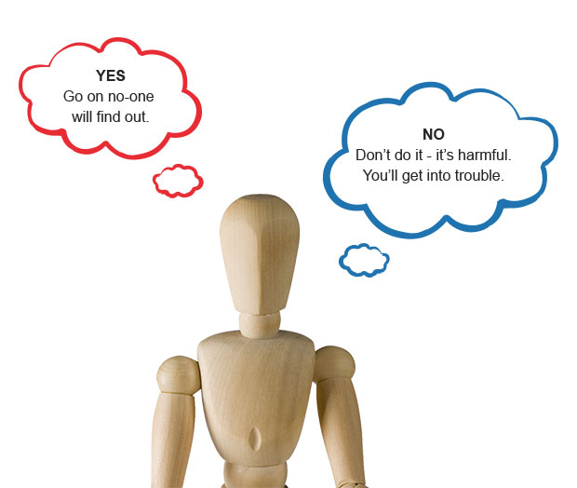
Pitfalls to avoid
Justifications
Rationalizations
Notes:
-it is tempting to use rationalizations to justify our actions
-we do this all the time-its okay to speed because everyone else is-I can go through that red light because no one is around
-red flag when start to do this in professional work-no one got hurt, the agency will never know, its okay to cut corners because I’m really busy, the agency policy is a dumb one anyway

Slide 49
Questions to ask yourself
Is this a legal issue?
Are there agency policies to guide me?
What is in the best interest of the family?
What is the ultimate goal?
Would I do this for every family?
Notes:
-would I do this for every family is often overlooked question
-would I go to all children’s birthday parties that I’m invited to? Would I give a Christmas gift to all families?

Slide 50
“When it comes to ethical decisions,
there are no answers, there are only decisions.”
Notes:
-remember that there is often not a “right” way to act

Slide 51
Questions?

Slide 52
References
Considering Ethical and Professional Behaviors. (2006). St. Louis, MO: Parents as Teachers National Center, Inc.
Considering Ethical and Professional Behaviors. (2017). St. Louis, MO: Parents as Teachers National Center, Inc.
“Ethical Considerations”. (2017). https://eclkc.ohs.acf.hhs.gov/ods/book/head-start/ethical-considerations/
“Frequently Asked Questions”. (2017). https://professionalboundaries.com/faq.php
Grise, C. (2012). “Ethics in Home Visiting”. https://www.healthandwelfare.idaho.gov/Portals/0/Children/InfantToddlerProgram/D7%20Ethics%20in%20Home%20Visiting%20PowerPoint%20Slides.pdf
“Professional and Ethical Issues in Home Visiting”. (2017). Retrieved from http://homevisiting.org/content/professional-and-ethical-issues-home-visiting
“Reflective Supervision on the Run”. (2003). National Head Start Association Magazine.
Roibal, H. (2013, August). “Boundaries in Home Visiting”. https://www.cdd.unm.edu/ecln/HVT/common/pdfs/2013_8.pdf

