Slide 1
Are Dads Important Too?
4/17/2019
Notes:
Welcome folks

Slide 2
Dr. Jennifer Bellamy
Bridget Cunningham
Tom Valand
Notes:
Inform audience about us and why they should pay attention to our words of wisdom
Note that we will be having a 15 minute Q+A at the end – so please save your questions.

Slide 3
Engaging Fathers in Home Visiting Services Dads Matter HV
Notes:
Fathers’ participation in child and family services has the potential to boost mothers’ engagement in interventions and extend outcomes (Arnold, O'leary, & Edwards, 1997; Eckenrode et al., 2000; Fals-Stewart, Fincham, & Kelley, 2004); and positive fathering has been linked to important home visiting outcomes such as child maltreatment prevention (Dubowitz, Black, Kerr, Starr Jr, & Harrington, 2000; Guterman, Lee, Lee, Waldfogel, & Rathouz, 2009). However, the field of home visitation has largely overlooked fathers’ roles in the family.

Slide 4
Fathers as a “Missing Piece” in Home Visitation
Growth of home visitation
Fathers and child maltreatment risk
Fathers and related child outcomes
Fathers shape the effectiveness of home visitation
Few home visitors report engaging fathers in services, and one of the barriers identified in prior literature has been home visitors’ attitudes toward working with fathers.
Notes:
Fathers’ participation in child and family services has the potential to boost mothers’ engagement in interventions and extend outcomes (Arnold, O'leary, & Edwards, 1997; Eckenrode et al., 2000; Fals-Stewart, Fincham, & Kelley, 2004); and positive fathering has been linked to important home visiting outcomes such as child maltreatment prevention (Dubowitz, Black, Kerr, Starr Jr, & Harrington, 2000; Guterman, Lee, Lee, Waldfogel, & Rathouz, 2009). However, the field of home visitation has largely overlooked fathers’ roles in the family.

Slide 5
The Dads Matter – HV Model
Notes:
Fathers’ participation in child and family services has the potential to boost mothers’ engagement in interventions and extend outcomes (Arnold, O'leary, & Edwards, 1997; Eckenrode et al., 2000; Fals-Stewart, Fincham, & Kelley, 2004); and positive fathering has been linked to important home visiting outcomes such as child maltreatment prevention (Dubowitz, Black, Kerr, Starr Jr, & Harrington, 2000; Guterman, Lee, Lee, Waldfogel, & Rathouz, 2009). However, the field of home visitation has largely overlooked fathers’ roles in the family.

Slide 6
Overall Study Methods
A multisite clustered RCT was conducted across five large organizations.
Mixed methods study of home visitors participating in the RCT including pre-test and one-year follow-up surveys (n=81)
Qualitative Component: and individual interviews (n=22) conducted after the follow-up survey.
Notes:
Fathers’ participation in child and family services has the potential to boost mothers’ engagement in interventions and extend outcomes (Arnold, O'leary, & Edwards, 1997; Eckenrode et al., 2000; Fals-Stewart, Fincham, & Kelley, 2004); and positive fathering has been linked to important home visiting outcomes such as child maltreatment prevention (Dubowitz, Black, Kerr, Starr Jr, & Harrington, 2000; Guterman, Lee, Lee, Waldfogel, & Rathouz, 2009). However, the field of home visitation has largely overlooked fathers’ roles in the family.

Slide 7
Worker Survey: Summary
Study-Developed Father Engagement Scale (r=.81)
Workers reported:
51% of the families they work with have a biological father involved
Fathers participate in 14% of visits
Overall very positive attitudes
Most commonly cited barriers to serving fathers:
Lack of time
Perception that fathers do not want to participate
Lack of training
Worry that if they work with fathers, it will take away from their work with mothers
Notes:
Fathers’ participation in child and family services has the potential to boost mothers’ engagement in interventions and extend outcomes (Arnold, O'leary, & Edwards, 1997; Eckenrode et al., 2000; Fals-Stewart, Fincham, & Kelley, 2004); and positive fathering has been linked to important home visiting outcomes such as child maltreatment prevention (Dubowitz, Black, Kerr, Starr Jr, & Harrington, 2000; Guterman, Lee, Lee, Waldfogel, & Rathouz, 2009). However, the field of home visitation has largely overlooked fathers’ roles in the family.

Slide 8
Engagement Outcomes: Summary
Mother relationship with home visitor not changed across condition
Father relationship with home visitor more favorable in intervention group
No correlation between mother and father reports
Fathers’ participation in the control group was half (17%) of what it was in the intervention group
Notes:
Fathers’ participation in child and family services has the potential to boost mothers’ engagement in interventions and extend outcomes (Arnold, O'leary, & Edwards, 1997; Eckenrode et al., 2000; Fals-Stewart, Fincham, & Kelley, 2004); and positive fathering has been linked to important home visiting outcomes such as child maltreatment prevention (Dubowitz, Black, Kerr, Starr Jr, & Harrington, 2000; Guterman, Lee, Lee, Waldfogel, & Rathouz, 2009). However, the field of home visitation has largely overlooked fathers’ roles in the family.

Slide 9
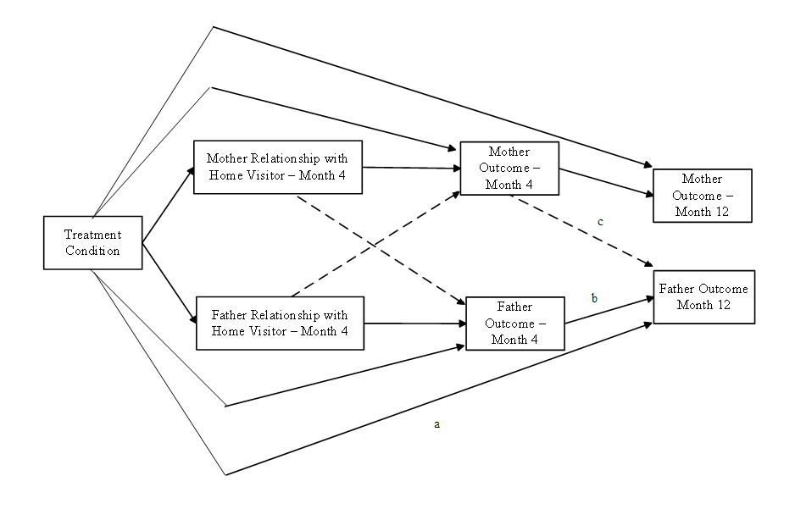
Data Analysis
Notes:
Fathers’ participation in child and family services has the potential to boost mothers’ engagement in interventions and extend outcomes (Arnold, O'leary, & Edwards, 1997; Eckenrode et al., 2000; Fals-Stewart, Fincham, & Kelley, 2004); and positive fathering has been linked to important home visiting outcomes such as child maltreatment prevention (Dubowitz, Black, Kerr, Starr Jr, & Harrington, 2000; Guterman, Lee, Lee, Waldfogel, & Rathouz, 2009). However, the field of home visitation has largely overlooked fathers’ roles in the family.

Slide 10
Father Engagement Strategies: Control Group
Incentives
Leave him information
Tell him he’s needed/important
Communicate through mom
Notes:
Fathers’ participation in child and family services has the potential to boost mothers’ engagement in interventions and extend outcomes (Arnold, O'leary, & Edwards, 1997; Eckenrode et al., 2000; Fals-Stewart, Fincham, & Kelley, 2004); and positive fathering has been linked to important home visiting outcomes such as child maltreatment prevention (Dubowitz, Black, Kerr, Starr Jr, & Harrington, 2000; Guterman, Lee, Lee, Waldfogel, & Rathouz, 2009). However, the field of home visitation has largely overlooked fathers’ roles in the family.

Slide 11
Father Engagement Strategies: Intervention Group
Talk to him
Make eye contact
Leave things for him
Communicate through Mom
Specifically/explicitly invite him
Tell him he’s needed/important
Referrals (jobs etc.)
Using hands-on activities
Use technology
Being there/consistent/building trust
Giving him information
Providing opportunities to interact with other dads
Explaining benefits of his involvement
Using “other” activities: holiday parties, family events, etc.
Respect/acknowledge his expertise
Consider schedules
Notes:
Fathers’ participation in child and family services has the potential to boost mothers’ engagement in interventions and extend outcomes (Arnold, O'leary, & Edwards, 1997; Eckenrode et al., 2000; Fals-Stewart, Fincham, & Kelley, 2004); and positive fathering has been linked to important home visiting outcomes such as child maltreatment prevention (Dubowitz, Black, Kerr, Starr Jr, & Harrington, 2000; Guterman, Lee, Lee, Waldfogel, & Rathouz, 2009). However, the field of home visitation has largely overlooked fathers’ roles in the family.

Slide 12
Intervention Group Practice Changes
More inclusion of fathers/paying attention to them in various aspects of services
Active encouragement of fathers and fathering
Reflection on their own perceptions and beliefs about fathers
More of a family approach
Talking to moms and dads about the importance of dad
Getting over discomfort, uncertainty, hesitation
Increasing skills
Notes:
Fathers’ participation in child and family services has the potential to boost mothers’ engagement in interventions and extend outcomes (Arnold, O'leary, & Edwards, 1997; Eckenrode et al., 2000; Fals-Stewart, Fincham, & Kelley, 2004); and positive fathering has been linked to important home visiting outcomes such as child maltreatment prevention (Dubowitz, Black, Kerr, Starr Jr, & Harrington, 2000; Guterman, Lee, Lee, Waldfogel, & Rathouz, 2009). However, the field of home visitation has largely overlooked fathers’ roles in the family.

Slide 13
Conclusions and Implications
Workers espouse generally positive attitudes and expectations about working with fathers
Important barriers to address:
Lack of time
Perception that fathers do not want to participate
Lack of training
Worry that if they work with fathers, it will take away from their work with mothers
Focus on actual skills/behavior change- and “getting over the hump”
Notes:
Fathers’ participation in child and family services has the potential to boost mothers’ engagement in interventions and extend outcomes (Arnold, O'leary, & Edwards, 1997; Eckenrode et al., 2000; Fals-Stewart, Fincham, & Kelley, 2004); and positive fathering has been linked to important home visiting outcomes such as child maltreatment prevention (Dubowitz, Black, Kerr, Starr Jr, & Harrington, 2000; Guterman, Lee, Lee, Waldfogel, & Rathouz, 2009). However, the field of home visitation has largely overlooked fathers’ roles in the family.

Slide 14
Acknowledgements
This research was primarily supported by a grant from the Fatherhood and Research Practice Network (FRPN)
The Research Team:
Stephanie Speer, MSW, Doctoral candidate, University of Denver
Jon Phillips, MSW, PhD Candidate, University of Denver
Shelby Thomas, BA, Master's student, University of Denver
Neil Guterman, PhD, Dean, New York University
Aaron Banman, PhD, Assistant Professor, University of Nebraska
Sandra Morales-Mirque, BA, Proj. Coordinator, University of Chicago
Notes:
Fathers’ participation in child and family services has the potential to boost mothers’ engagement in interventions and extend outcomes (Arnold, O'leary, & Edwards, 1997; Eckenrode et al., 2000; Fals-Stewart, Fincham, & Kelley, 2004); and positive fathering has been linked to important home visiting outcomes such as child maltreatment prevention (Dubowitz, Black, Kerr, Starr Jr, & Harrington, 2000; Guterman, Lee, Lee, Waldfogel, & Rathouz, 2009). However, the field of home visitation has largely overlooked fathers’ roles in the family.

Slide 15
Lessons Learned on the Front Line

Slide 16
Dad’s Initial Motivations

Slide 17
How We Successfully Engage Fathers

Slide 18
Meet them where they are
Set achievable goals
Be patient and flexible
Empower them to advocate for themselves
Utilize content tailored to dads
Notes:
Importance of trust and how to build it

Slide 19
Benefits
Job opportunities
Awareness of services
Increase in caregiving + parenting skills
Improved anger and stress management
Notes:
Fathers’ participation in child and family services has the potential to boost mothers’ engagement in interventions and extend outcomes (Arnold, O'leary, & Edwards, 1997; Eckenrode et al., 2000; Fals-Stewart, Fincham, & Kelley, 2004); and positive fathering has been linked to important home visiting outcomes such as child maltreatment prevention (Dubowitz, Black, Kerr, Starr Jr, & Harrington, 2000; Guterman, Lee, Lee, Waldfogel, & Rathouz, 2009). However, the field of home visitation has largely overlooked fathers’ roles in the family.

Slide 20
Notes:
We can help build upon the toolbox and confidence of fathers to help them be positively engaged.

Slide 21
Mission
Improve the ability of area dads to positively impact their children’s lives by increasing their support network, providing tools, and creating bonding opportunities for them and their families.
Vision
All fathers within Routt County are positively engaged and impactful within the lives of their families.
FATHERHOOD
PROGRAM
Of ROUTT COUNTY

Slide 22
What We do
One-on-One Support
Role modeling for our children
Managing anger / Resolving conflict
Divorce and custody support
Referral Services
Parenting / Relationship Education
Nurturing Father’s Program
Boot Camp for New Dads
Fathering and Child Bonding Events
Fly Fishing
All Pro Dad Father and Child Breakfast
Advocacy for Fathers within the Community
Steamboat Pilot Articles
Facebook page – www.facebook.com/dadswz

Slide 23
Evidence-based workshop for expectant first time dads (Rookies) held at birthing facility
New fathers (Veterans)bring their babies and knowledge to share with the group
Supporting baby and mom
Going back to work
Protecting yourself and family
Notes:
~30 year old organization with programming across the country. Most importantly - 20+ sites in the Denver metro area alone. Google the site to find the location nearest you.
I used the St Josephs location

Slide 24
Supporting your family in and out of jail
Re- Entry planning
Conflict resolution
Co-Parenting
Managing and Expressing Emotions
Goal Setting
Managing a Budget
Evidence-based class for incarcerated fathers

Slide 25
Role Modeling
Managing and Expressing Emotions
Effective Discipline
Communication and Problem Solving
13 session evidence-based class that builds upon the nurturing and parenting skills of men

Slide 26
Supporting Hard to Reach Dads
Get to know him
Cultural background
Interests
Commitment to child
Work schedule and skills
Notes:
Leverage
- Relationships he has in the community
- Respect he has in other community members, celebrities
- Shortcomings he experienced in his childhood

Slide 27
Supporting Hard to Reach Dads
Meet him where he is
At work
At childcare facility
Utilize technology
Apps, podcasts and audiobooks

Slide 28
Notes:
App for hard to reach dads to learn at their own pace

Slide 29
Contact your local CPNFF Member
Notes:
Dads may be at different levels of readiness
Give pitch re CPNFF (Fatherhood Network)

Slide 30
Notes:
Dads may be at different levels of readiness
Give pitch re CPNFF (Fatherhood Network)

