Slide 1
Maintaining Professional Boundaries and Ethics in the Home Visitation Setting
Michele Provost, LCSW PAT Program Director

Slide 2
Why care about ethics and boundaries?
Have you been in a situation where you felt uncomfortable about a decision you had to make about:
  a family you’re working with?
  a co-worker?
  your agency?
Notes:
How often do uncomfortable situations come up?
Invitation to a party given by a family you’re working with? Given gifts by families you’re working with?
A co-worker who is selling products from her direct marketing business to clients?
An agency who asks you to exaggerate services to make it look like they’re serving more people than they actually are?

Slide 3
Why care about ethics and boundaries?
Have you been in a situation where you felt your personal or cultural values were challenged working with a specific family?
Notes:
The family was a different religion than you.
The family had a different child rearing outlook than you.
Everyone who has worked in this field has had these types of situations come up. Situations where you weren’t sure how to act or what the right thing to do is or whether you should say something or not.

Slide 4
Objectives
Define role of home visitor
Define core concepts & terminology
Common situations
How to prepare
Activity

Slide 5
Home Visitor or Friend?
Providing a specific service
Time limited
One-sided
Involves paperwork
One person getting paid
Notes:
Are these the characteristics of a home visitor/parent educator or a friend?
Is this a personal or professional relationship?

Slide 6
Home Visitor or Friend?
  Casual
  Personal
  Intimate
  Trusting
  Relationship based
Notes:
How about these characteristics? It’s less obvious whether this is describing a friend or a professional relationship.
These characteristics occur in the relationships with your families, right?
Similarities to friendships

Slide 7
Core Concepts & Terminology
Values
Morals
Ethics
Boundaries
Notes:
Before going further, it will be helpful to look at some of the terms and definitions commonly used in the area of ethics and boundaries.
What do you think of when you see these terms?
Do they mean the same things? Different things?

Slide 8
Values
What a person believes to be of importance and worth
How we judge our conduct and character
Influenced by outside forces
Notes:
Values can be influenced by our family, friends, education, culture, media, religion, among other things.

Slide 9
Morals
Specific type of value
Often from outside the individual
Culture and religion of high influence
Notes:
Morals are specific types of values.
Often come from a structure outside the individual, like the government, faith-based institutions, or the society where we live.
Often things we are most uncomfortable discussing in the workplace or with people we don’t know well due to a fear of offending someone.

Slide 10
Ethics
Branch of philosophy
Study of the moral principals that guide our decision making and behavior
Notes:
Ethics seek well reasoned accounts of what should be good and right behaviors.
We say someone is acting ethically when they act in a way that follows ethical principles that reasonable people would accept as guides for decision making and behavior.
Ethics is a field that is alive and evolving. Experience and events shape what a society might view as ethical.
Right to die legislation or stopping medical treatment are examples of current issues related to ethics and ethical decision making.
Lots of different types of organizations have an ethics board or ethics committee, especially hospitals and medical groups. These committees are consulted when an ethical issue or decision needs to be made. They help those involved to make difficult decisions where the “right” path isn’t always clear or there is no “right” path.

Slide 11
"When it comes to ethical decisions, there are no answers, there are only decisions."
—Mel Gray and Jill Gibbons
Notes:
These types of issues come up often and we need to be prepared to deal with them.
Important to note that there are often no right or wrong answers to many ethical or boundary related issues.
Many factors influence how we behave and what we do in specific unclear situations.

Slide 12

Boundaries
Differences between a professional and personal relationship with someone
Notes:
Boundaries is the invisible line between a personal relationship and a professional relationship.
When you have dinner and see a movie with your friend, but would not do that with a family you’re working with, you’ve set a boundary.
Behavior that is okay and acceptable for one type of relationship, but is not acceptable for another type of relationship.
We set boundaries with our relationships all the time…we are sometimes the one that defines those boundaries in a relationship, other times they are set by the other person in a relationship.

Slide 13

Boundaries
Not always clear
Easy to violate
Self-disclosure
Notes:
The problem with boundaries is they are not always clear.
The very nature of what we do, as we talked about earlier, being in people’s homes, forming relationships and the intimacy that creates, makes setting and maintaining boundaries sometimes challenging.
How much self-disclosure is too much? Important in forming a trusting relationship, but it is not an equal level of sharing.

Slide 14
Common Ethical Situations
Confidentiality
  How to maintain records
  Outcome measure reporting
  When to violate it
  Setting expectation early
Notes:
We are going to explore the most common situations where ethical and boundary situations arise.
This can be about the maintenance of records, both paper and electronic.
How to use outcome and assessment results.
Communicating with other involved agencies.
When its okay to violate it.
Important to set this expectation from the beginning.

Slide 15
Common Ethical Situations
Dual relationship
  Involved with an individual in one or more ways
Notes:
Dual relationships with others can often be tricky and hard to navigate.
Co-workers…your boss is also someone you hang out with and are friends with.
You and your doctor go to the same church.
Hard to avoid in small communities…you may see your clients at the grocery store, at community events, or at your children’s school.
They are not always ethical violations, but do require more consideration and communication.

Slide 16
Common Ethical Situations
Competency & professional limits
  Practicing outside level of competency
Notes:
Problems can arise when professionals exceed the limits of their level of competency and/or outside the job they were hired to do.
When a situation arises that is beyond your expertise, it is important to use your resource and referral network.
Refer families to medical personnel, family therapists, developmental specialists, etc.

Slide 17
Common Ethical Situations
  Respect for individuals, families and their culture
Notes:
Working with families that have different values and morals than you do.
Maintaining respect and a successful working relationship with families where you strongly disagree with their choices and behavior.
Hard to do sometimes, but critical to the success of a trusting relationship.

Slide 18

Common Ethical Situations
  Terminating service
    How and when?
    How to communicate decision
    Transferring family
Notes:
How to handle situations of repeated “no-shows”.
How to handle situations where parent isn’t participating or benefiting from services.
Can you keep seeing a family because you “like” them?
Sometimes it is deemed best to transfer a family to another home visitor. Why? How is that handled?

Slide 19
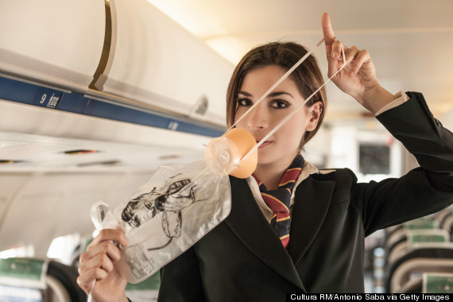
Common Ethical Situations
  Responsibility to self
    Obligation to yourself and those you care about
    Be aware of signs of stress and burnout
    Self-care plans
Notes:
What is one of the things flight attendants say in their safety instructions about oxygen masks?
Put yours on first before helping others, right?
As professionals, we have an obligation to take care of ourselves. If you are exhausted from working 7 days a week, you will not be effective with your clients.
Its important to know yourself and the signs when you need a break. Also important to know what helps you get re-charged.

Slide 20
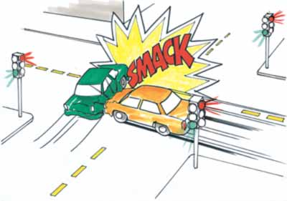
Collisions
Ourselves
Clients
Agency
Community
Notes:
All people have their individual set of values, morals, ethical framework and boundaries that guide and affect our behavior.
Agencies and communities have values, ethical frameworks and boundaries as well.
Sooner or later, these are going to come in conflict and collide with each other.
What to do then?

Slide 21
Preparation is key
Legal issues
Your profession’s guidelines
Agency’s policies
Know your “hot buttons”
Use reflective supervision
Notes:
Situations where you are unsure how to act are going to happen.
Being ready for them will help you make better decisions in the moment and/or know where to turn when you’re in trouble.
We’ll go in each one in a bit of detail.

Slide 22
Legal Issues
Mandatory reporter
Other issues
  Transportation
  Liability insurance
Notes:
Important to know any legal issues related to your practice.
All mandatory reporters for child abuse/neglect.
What about suspected elder abuse? Varies by state.
Other issues like transportation of clients raise legal issues for agencies.

Slide 23
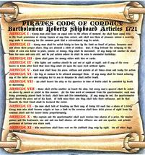
What is a Code of Ethics?
Guides professionals in their work
Identifies expectations of behavior
Notes:
What is the purpose of a Code of Ethics?
Defines professional behavior and expectations.
Can be a guide for how to act in unsure situations.

Slide 24
Ethical Codes and Standards of Practice
National Association of Social Workers
  http://Naswdc.org/pubs/code/code.asp
National Association for the Education of Young Children
  http://naeyc.org/files/naeyc/file/positions/PSETH05.pdf
American Nurses Association
  http://nursingworld.org/codeofethics
American Counseling Association
  https://www.counseling.org/resources/aca-code-of-ethics.pdf
  American Psychological Association
    http://apa.org/ethics/code/index.aspx
Notes:
Because home visitors are often made up of different professions, levels of education, and licensure, there is not Code of Ethics or Standards of Practice specifically for home visitors or parent educators
Other professional organization that are related to home visiting have developed their own.
It is a good idea to be familiar with the code of ethics of your specific professional organization.

Slide 25

Agency Policies
Policies, practices and guidelines for parent educator and home visitor behavior
Notes:
You must know your specific agency polices regarding your interaction with families.
Every agency may have different policies and guidelines for behavior in such areas as transporting families in your personal vehicle, social media, contact with families outside of work, accepting and receiving gifts, just to name a few.
You need to be familiar with these policies because you will be held accountable to maintaining them.
Many of these polices are put in place to protect both the employee and the families you serve.

Slide 26

Hot Button Issues
Religion
LGBT families
Abortion/contraception
Co-habitation
Parent/child co-sleeping
Marijuana use
Politics
Vaccinations
Obesity
Immigration status
Criminal history
Medical care
Notes:
We all have issues and behaviors that “push our buttons”…that serve as triggers.
Important to know what those are and “check” them at the door when working with a family.
Your “hot button” will get pushed at some point, its just a matter of when and by who.

Slide 27
Reflective Supervision
3 key components
  Reflection
  Collaboration
  Regularity
Notes:
Reflective supervision is key to ethical and professional practice.
Supportive and collaborative in nature.
Active listening and thoughtful questioning by both supervisor and staff member.
Reflective supervision is a process built on a foundation of trust and acceptance over time.
This is the place to discuss your “hot buttons” issues or situations that you find challenging.

Slide 28

Pitfalls to Avoid
Justifications
Rationalizations
Notes:
When there is a strong conflict between what we are asked to do and what we feel we should do, it is tempting to use rationalization to justify our actions.
We do this frequently…its okay to speed when I’m just going with the traffic or its okay to go through the red light because no one is around.
It should be a red flag when we start to do this with our work life…Its okay because everyone is doing it…my intentions were good…no one got hurt…the agency will never know…its okay to cut corners because I’m really busy.

Slide 29
Questions to ask
Legal issues?
Agency policies and practices?
What is in the best interest of the family?
What is the ultimate goal?
  Long and short term
Would I do this for every family?
Notes:
When faced with a dilemma about how to behave, whether to do something for your client or not, important to start with these questions.
Laws about it? Agency policies about it? Consult your supervisor?
What is in the best interest of the family?
What is the ultimate goal?
Often overlooked…would I do this for every family?

Slide 30

Activity

Slide 31
References
Considering Ethical and Professional Behaviors. (2006). St. Louis, MO: Parents as Teachers National Center, Inc.
“Ethical Considerations”. (2017). https://eclkc.ohs.acf.hhs.gov/ods/book/head-start/ethical-considerations/
“Frequently Asked Questions”. (2017). https://professionalboundaries.com/faq.php
Grise, C. (2012). “Ethics in Home Visiting”. https://www.healthandwelfare.idaho.gov/Portals/0/Children/InfantToddlerProgram/D7%20Ethics%20in%20Home%20Visiting%20PowerPoint%20Slides.pdf
“Professional and Ethical Issues in Home Visiting”. (2017). Retrieved from http://homevisiting.org/content/professional-and-ethical-issues-home-visiting
“Reflective Supervision on the Run”. (2003). National Head Start Association Magazine.
Roibal, H. (2013, August). “Boundaries in Home Visiting”. https://www.cdd.unm.edu/ecln/HVT/common/pdfs/2013_8.pdf

